Slide 1

Cost-Effective Route
Mapping System
By-Kishor Zatale(BT22CSD010)
Ayush Khaire(BT22CSD028)
Parth Chaturvedi(BT22CSD034)
Ashutosh Sahoo(BT22CSD062)
Guided by-Dr Madhavi Netke

Slide 2

Cost-Effective Route
Mapping System
Efficiently finding the most cost-effective and shortest route between two Indian cities is a common challenge. The A* algorithm presents a powerful solution to this problem, leveraging its ability to navigate complex networks and identify the optimal path.

Slide 3

Introduction to the Problem
Imagine traveling from Mumbai to Delhi. You want to find the most efficient path considering both distance and cost.
1
Minimizing Distance
2
Minimizing Cost
Travelers seek the shortest route to save time and fuel.
Financial considerations are crucial, especially when traveling long distances.
Complex Road Network
3
India's vast road network presents various options, making finding the optimal path complex.

Slide 4
DataSet Used
The dataset utilized in this project provides detailed information on the distances and costs associated with traveling between various cities in India. This data is essential for implementing the A* algorithm, which relies on distance and cost metrics to identify the most cost-effective route between selected cities.
Source: https://www.kaggle.com/code/kbdharun/a-star-route-finding/input
Attributes:
Source: Starting city of each route
Destination: Ending city of each route
Distance: Distance in kilometers between the cities
Price: Estimated travel cost in currency units

Slide 5





Implementing A* for Travel Planning
The A* algorithm can be implemented to find the optimal travel path between two cities in India.
Data Representation
The road network is represented as a graph, with cities as nodes and roads as edges.
Cost and Distance Calculation
Each edge is assigned a cost and distance value, representing the travel cost and distance. Considering the path price as Heuristic value. f(n) = g(n) + h(n): The total estimated cost. g(n) and f(n) are cost and heuristic function respectively.
Path Finding
The A* algorithm is applied to the graph, starting at the source city and navigating towards the destination.
Result Output
The algorithm provides the optimal path with the lowest combined distance and path cost.

Slide 6
Optimizing Path Planning
Graph Extraction from Dataset
def extract_graph(data):
graph = Graph()
for row in data:
source = row['Source']
destination = row['Destination']
distance = int(row['distance'])
price = int(row['price'])
graph.connect(source, destination, distance, price)
return graph
Graph Structure and Class Definition
class Graph:
def __init__(self, graph_dict=None, directed=True):
self.graph_dict = graph_dict or {}
self.directed = directed
if not directed:
self.make_undirected()
def make_undirected(self):
for a in list(self.graph_dict.keys()):
for b, values in self.graph_dict[a].items():
self.graph_dict.setdefault(b, {})[a] = values
def connect(self, A, B, distance=1, price=0):
self.graph_dict.setdefault(A, {})[B] = {'distance': distance, 'price': price}
if not self.directed:
self.graph_dict.setdefault(B, {})[A] = {'distance': distance, 'price': price}
def get(self, a, b=None):
links = self.graph_dict.setdefault(a, {})
if b is None:
return links
else:
return links.get(b)

Slide 7
Implementing the A* Algorithm
import heapq
def astar_search_min_price(graph, start, end):
open_list = [] # Priority queue for nodes to explore
heapq.heappush(open_list, (0, 0, start, [])) # Initialize queue with (price, distance, city, path)
visited = set() # Track visited cities
while open_list:
total_price, total_distance, current_city, path = heapq.heappop(open_list)
if current_city == end: # Destination reached
path.append(current_city)
return path, total_distance, total_price
if current_city not in visited:
visited.add(current_city)
for neighbor, values in graph.get(current_city).items():
distance = values['distance']
price = values['price']
new_price = total_price + price
new_distance = total_distance + distance
heapq.heappush(open_list, (new_price, new_distance, neighbor, path + [current_city]))
return None, float('inf'), float('inf') # No path found

Slide 8
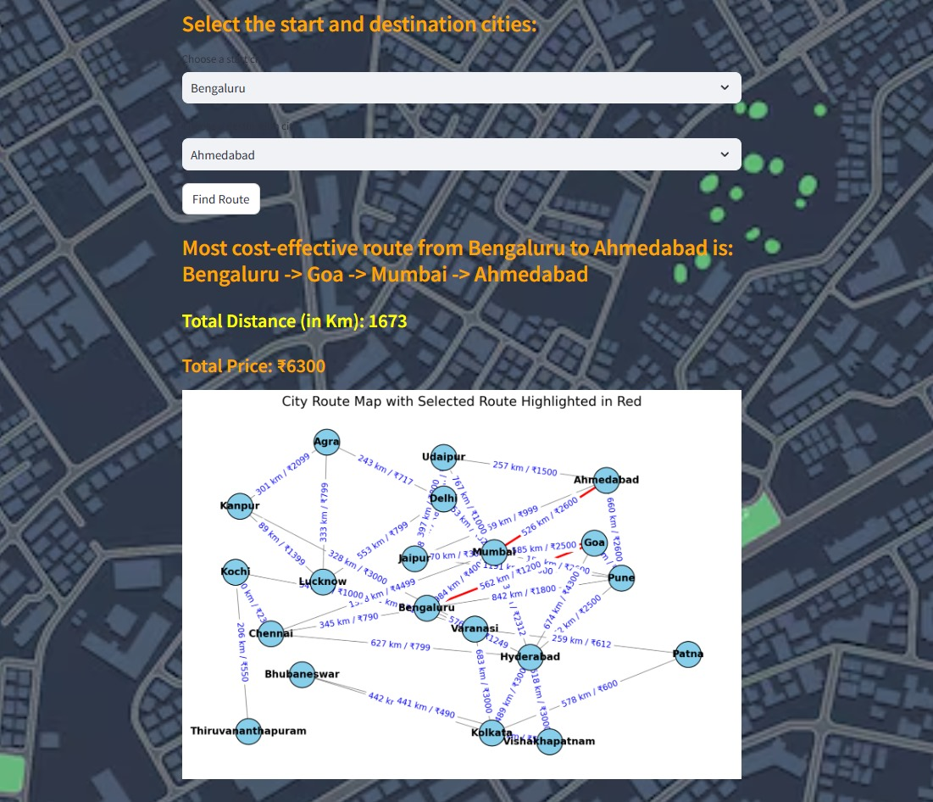
Output of Optimal Bus Route

Slide 9
Advantages of this System
Cost-Effective Route Optimization - The project finds the cheapest travel route between cities, enabling users to minimize their travel expenses by considering both distance and price.
Enhanced Decision-Making for Users - Users are provided with clear information on total travel cost and distance, allowing them to make informed choices based on their priorities, whether that’s minimizing cost or distance.
Practical Applications in Various Industries - This route-finding tool can be beneficial for logistics companies, tourism services, and individual travelers, offering optimized routes that can reduce transportation costs and enhance travel planning.
Scalability and Flexibility - The modular structure of the code allows easy adaptation for additional data, like new cities or updated prices, making it flexible for future expansions and real-world use.

Slide 10
Conclusion
This project successfully implemented the A* pathfinding algorithm to identify the shortest path between cities in a network. By leveraging A*'s efficient heuristic-based approach, we could highlight the optimal route between any two cities, emphasizing its suitability for navigation and logistics applications. Visualizing the graph with nodes representing cities and edges representing routes with distances enabled clear insights into the connections and optimal paths. The project demonstrates how AI-driven algorithms can optimize real-world problems involving route selection and pathfinding, providing a foundation for more complex applications in transportation, urban planning, and network design.

Slide 11
Future Aspects
Integration with Google Maps API: Integrating the Google Maps API would allow the system to retrieve real-time data for a larger number of cities, including live traffic conditions, road closures, and updated routes. This integration would enable dynamic path recalculation based on real-time traffic, making the pathfinding solution practical for real-world navigation applications, similar to popular GPS navigation systems.
Optimizing for Multiple Modes of Transport: Future versions could incorporate multiple modes of transport, such as walking, cycling, and public transit, allowing users to select or combine transportation methods for optimized route planning. This enhancement would support multimodal journeys, factoring in the time and cost of switching between transport types (e.g., subway to bus to walking).

Slide 12


